Slide 1

Carbon Nanofiber Based Volatile Organic Compound Sensor
Presented by:
Sukesh Kumar
Prepared by:
Pratap Maity
Department of Materials Science and Metallurgical Engineering, IIT Hyderabad

Slide 2
Introduction
Why CNFs?
Materials explored in this work
Experiments
Bacterial cellulose synthesis
Pyrolysis of Biomasses
Functionalization of CNFs
Characterization
XRD analysis
FTIR analysis
SEM analysis
EDAX analysis
Adsorption-desorption Experiment
FTIR study
Dispersed solution preparation
Device fabrication
Results
Mechanism
Conclusion & future perspective
Content

Slide 3
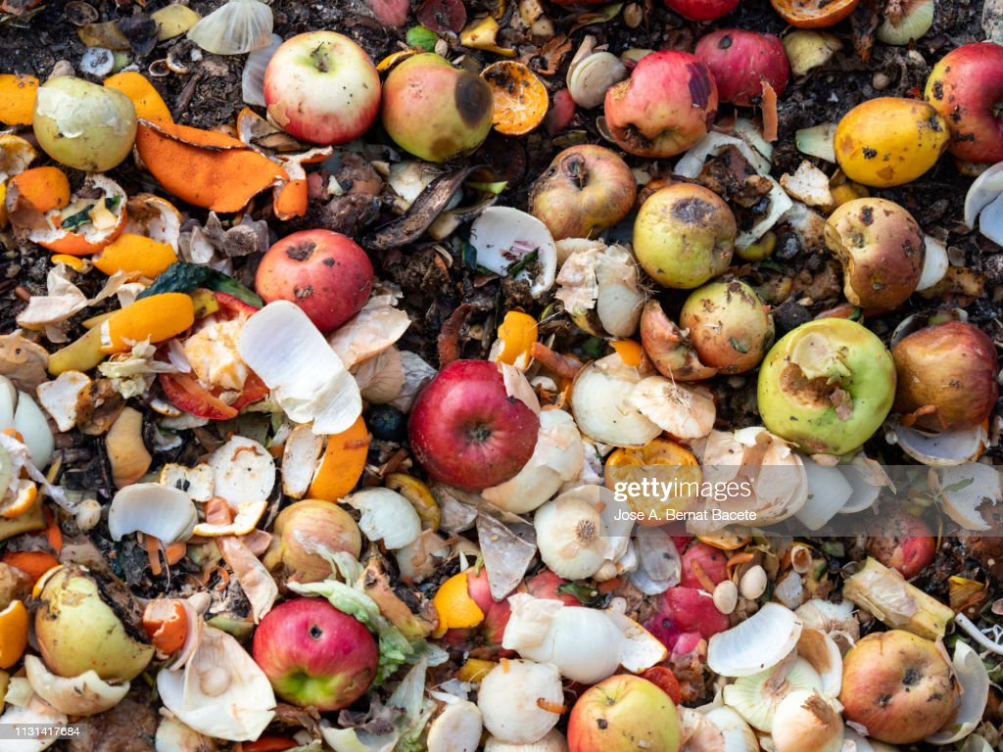
Introduction
Spoilage of fruits & vegetables (FAVs) is a critical issue worldwide.
Earlier detection of spoiling or infectious FAVs can lead to better nourishment.
This will be helpful in the following aspects:
- Reduced food waste
- Improved food safety
- Improved supply chain efficiency
- Cost saving
- Sustainability
To develop a Carbon nanofiber(CNF)-based sensor for detecting Volatile Organic Compounds (VOCs) released by fruits.
VOCs are the indicator of fruit spoilage.
Detecting acetone, EtOH & IPA.

Slide 4
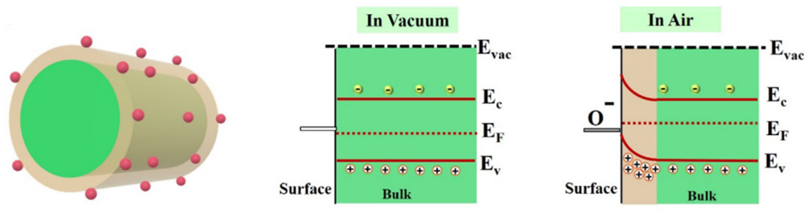
II. Mechanism
P-type semiconducting core
Electron depletion layer
Adsorbed O₂ species
E_{vac}, E_{c}, E_{F}, E_{v} represents the energies of vacuum level, conduction band, Fermi level & valance band
O₂ (gas) O₂ (adsorbed)
O₂ (adsorbed) O²⁻ / 2O⁻
C₂H₅OH + 3O²⁻ 2CO₂ +3H₂O + 6e⁻
C₃H₆O + 4O²⁻ 3 CO2 + 3H₂O + 8e⁻
Charge carrier got neutralized
Resistance increased
Current decreased
Lawaniya, Shiv Dutta, et al. "Functional nanomaterials in flexible gas sensors: recent progress and future prospects." Materials Today Chemistry 29 (2023): 101428.
Sinha, Madhumita, et al. "Fast response and low temperature sensing of acetone and ethanol using Al-doped ZnO microrods." Physica E: Low-dimensional Systems and Nanostructures 118 (2020): 113868.

Slide 5

Thank you

